Slide 1
Reanalysis of Bee Bread data
12-20-23
GC

Slide 2
Iteratively rarefied instead of CLR transformation.
We can use this paper to respond to the reviewer's comments regarding CLR transformation and why we opted to use rarefaction. – I’ve done this in the R2R letter.
https://journals.asm.org/doi/10.1128/msphere.00355-23
https://doi.org/10.1101/2023.06.23.546313
The next slides are the new results in line with how they appear in the manuscript.

Slide 3
Summary of sequence data
The final dataset now consists of 941 ASVs – text updated.
Number of ASVs per dominant group and abundance – text updated

Slide 4
Bee bread bacterial alpha diversity
This has been re-analyzed with “site” as a random effect using the lme4 package – methods updated.
Models: Y ~ Treatment * Time | Site
Shannon – no significant predictors of Shannon diversity, random effect is not significant.
Chao1 – Treatment * Timepoint (F = 3.3102, P = 0.04), individual predictors are not significant, random effect is significant (P < 0.001)
Observed - no significant predictors of Richness, random effect is significant (P < 0.001).

Slide 5
Beta diversity – methods updated
New model specification: Dist ~ Treatment * Timepoint, strata = Site, perm 1000.
Weighted:
adonis2(formula = dist_w ~ Treatment * Timepoint, data = sd_adonis, permutations = 1000, strata = sd_adonis$Site)
Df SumOfSqs R2 F Pr(>F)
Treatment 2 0.03192 0.01673 0.5876 0.48252
Timepoint 1 0.06154 0.03225 2.2660 0.04995 *
Treatment:Timepoint 2 0.02211 0.01159 0.4071 0.70430
Residual 66 1.79238 0.93943
Total 71 1.90795 1.00000
Pairwise permanova shows no differences among treatments
Unweighted:
adonis2(formula = dist_uw ~ Treatment * Timepoint, data = sd_adonis, permutations = 1000, strata = sd_adonis$Site)
Df SumOfSqs R2 F Pr(>F)
Treatment 2 0.3192 0.02593 0.9432 0.331668
Timepoint 1 0.4933 0.04007 2.9154 0.000999 ***
Treatment:Timepoint 2 0.3296 0.02678 0.9740 0.249750
Residual 66 11.1670 0.90722
Total 71 12.3090 1.00000
Pairwise permanova shows no differences among treatments

Slide 6
Full community part of Figure 2 (AB)
Notes:
Full community

Slide 7
Post treatment effect of miticide – methods updated
New model specification: Dist ~ Treatment * Timepoint, strata = Site, perm 1000.
Weighted
adonis2(formula = dist_wb ~ Treatment, data = sd_adonis, permutations = 1000, strata = sd_adonis$Site)
Df SumOfSqs R2 F Pr(>F)
Treatment 2 0.02089 0.02462 0.4165 0.6563
Residual 33 0.82759 0.97538
Total 35 0.84848 1.00000
No pairwise differences in treatment
Unweighted
adonis2(formula = dist_uwb ~ Treatment, data = sd_adonis, permutations = 1000, strata = sd_adonis$Site)
Df SumOfSqs R2 F Pr(>F)
Treatment 2 0.2953 0.05616 0.9818 0.05694 .
Residual 33 4.9627 0.94384
Total 35 5.2579 1.00000
Pairwise differences in between the CF and ORG treatments (F_{1,22} = 1.25, P = 0.02)

Slide 8
Ordinations time 2 – post treatment

Slide 9
Responses of acidophilic bacterial taxa to miticide treatment – methods updated
Still differences in lacto bac
Acetobacteraceae
OTU 282 – no longer significant – p = 0.105
OTU 122 – p = 0.004
Pairwise test p-values : aceto_df$OTU_122 and aceto_df$Treatment
CF CON
CON 0.3017 -
ORG 0.0032 0.0329

Slide 10
Core bee bread bacterial taxa
15 core members – text updated to reflect this
Both time points together
Weighted
adonis2(formula = dist_core_w_genus ~ Treatment * Timepoint, data = sd_adonis, permutations = 1000, strata = sd_adonis$Site)
Df SumOfSqs R2 F Pr(>F)
Treatment 2 0.1453 0.01929 0.6770 0.37862
Timepoint 1 0.1995 0.02649 1.8595 0.07293 .
Treatment:Timepoint 2 0.1059 0.01406 0.4935 0.59540
Residual 66 7.0826 0.94016
Total 71 7.5333 1.00000
Unweighted
adonis2(formula = dist_core_uw_genus ~ Treatment * Timepoint, data = sd_adonis, permutations = 1000, strata = sd_adonis$Site)
Df SumOfSqs R2 F Pr(>F)
Treatment 2 0.01790 0.01247 0.4651 0.715285
Timepoint 1 0.13318 0.09274 6.9195 0.001998 **
Treatment:Timepoint 2 0.01460 0.01017 0.3792 0.802198
Residual 66 1.27028 0.88462
Total 71 1.43596 1.00000
When split by timepoint, there were no significant predictors of beta-diversity for the core taxa.

Slide 11
Core ordinations (figure 2 CD)

Slide 12
Additional analyses and figures.

Slide 13
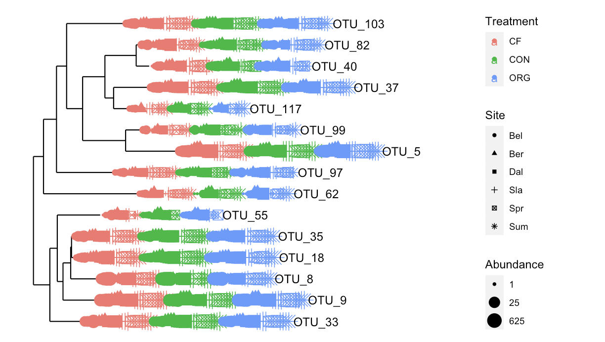
Core phylogenetic tree
We will need to add the taxonomic assignments to this. Additionally, I don’t think the abundance argument really gives any additional info here. I think the tree on the next slide is easier to understand.
I’ve also included the taxonomy info so we can add this info by hand.

Slide 14
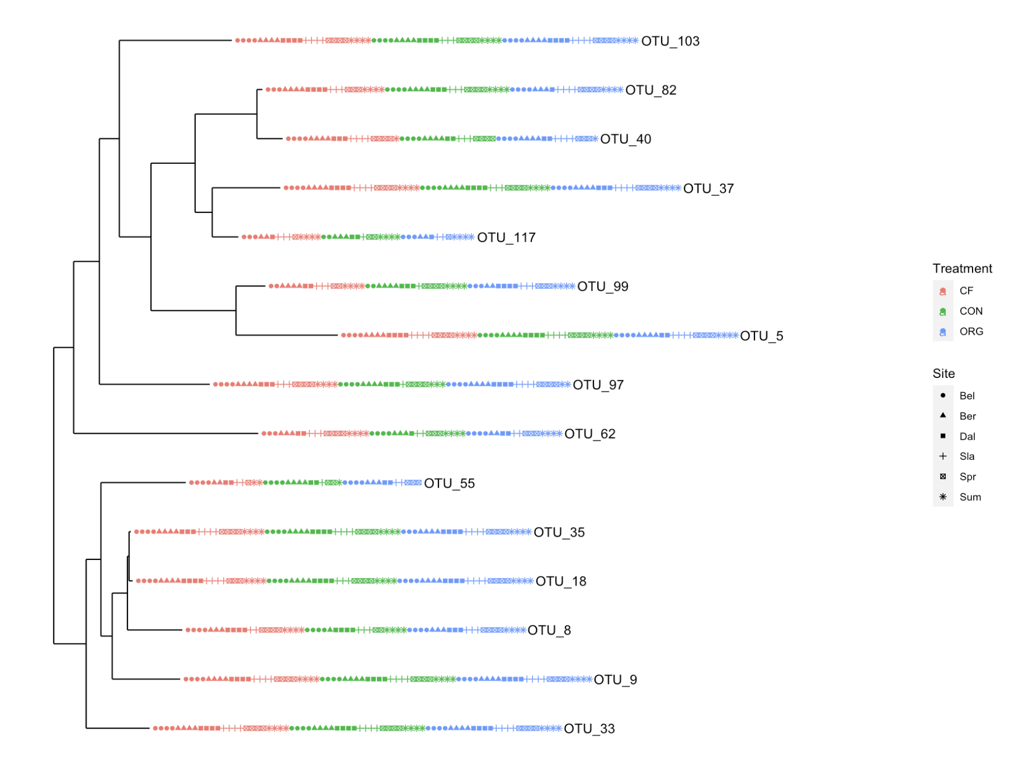
Taxonomy Table: [15 taxa by 7 taxonomic ranks]:
Kingdom Phylum Class Order Family Genus Species
OTU_5 "Bacteria" "Firmicutes" "Bacilli" "Lactobacillales" "Lactobacillaceae" "Apilactobacillus" NA
OTU_8 "Bacteria" "Proteobacteria" "Gammaproteobacteria" "Enterobacterales" "Morganellaceae" "Arsenophonus" NA
OTU_9 "Bacteria" "Proteobacteria" "Gammaproteobacteria" "Pseudomonadales" "Moraxellaceae" "Acinetobacter" NA
OTU_18 "Bacteria" "Proteobacteria" "Gammaproteobacteria" "Enterobacterales" "Enterobacteriaceae" "Raoultella" NA
OTU_33 "Bacteria" "Proteobacteria" "Gammaproteobacteria" "Pseudomonadales" "Pseudomonadaceae" "Pseudomonas" NA
OTU_35 "Bacteria" "Proteobacteria" "Gammaproteobacteria" "Enterobacterales" "Erwiniaceae" "Pantoea" NA
OTU_37 "Bacteria" "Proteobacteria" "Alphaproteobacteria" "Sphingomonadales" "Sphingomonadaceae" "Sphingomonas" NA
OTU_40 "Bacteria" "Proteobacteria" "Alphaproteobacteria" "Acetobacterales" "Acetobacteraceae" NA NA
OTU_55 "Bacteria" "Proteobacteria" "Gammaproteobacteria" "Burkholderiales" "Oxalobacteraceae" "Duganella" NA
OTU_62 "Bacteria" "Bacteroidota" "Bacteroidia" "Flavobacteriales" "Weeksellaceae" "Chryseobacterium" NA
OTU_82 "Bacteria" "Proteobacteria" "Alphaproteobacteria" "Acetobacterales" "Acetobacteraceae" "Bombella" NA
OTU_97 "Bacteria" "Actinobacteriota" "Actinobacteria" "Micrococcales" "Microbacteriaceae" "Curtobacterium" NA
OTU_99 "Bacteria" "Firmicutes" "Bacilli" "Paenibacillales" "Paenibacillaceae" "Paenibacillus" NA
OTU_103 "Bacteria" "Proteobacteria" "Alphaproteobacteria" "Rhizobiales" "Beijerinckiaceae" "Methylobacterium-Methylorubrum" NA
OTU_117 "Bacteria" "Proteobacteria" "Alphaproteobacteria" "Rhizobiales" "Rhizobiaceae" "Aureimonas" NA

Slide 15
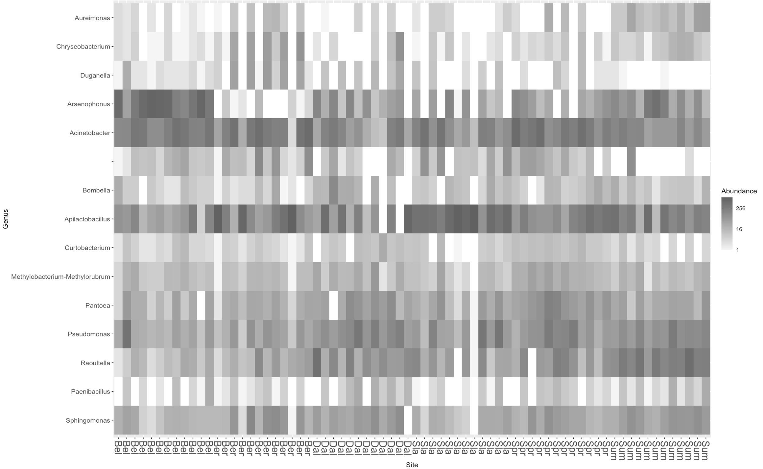
heatmap

Slide 16
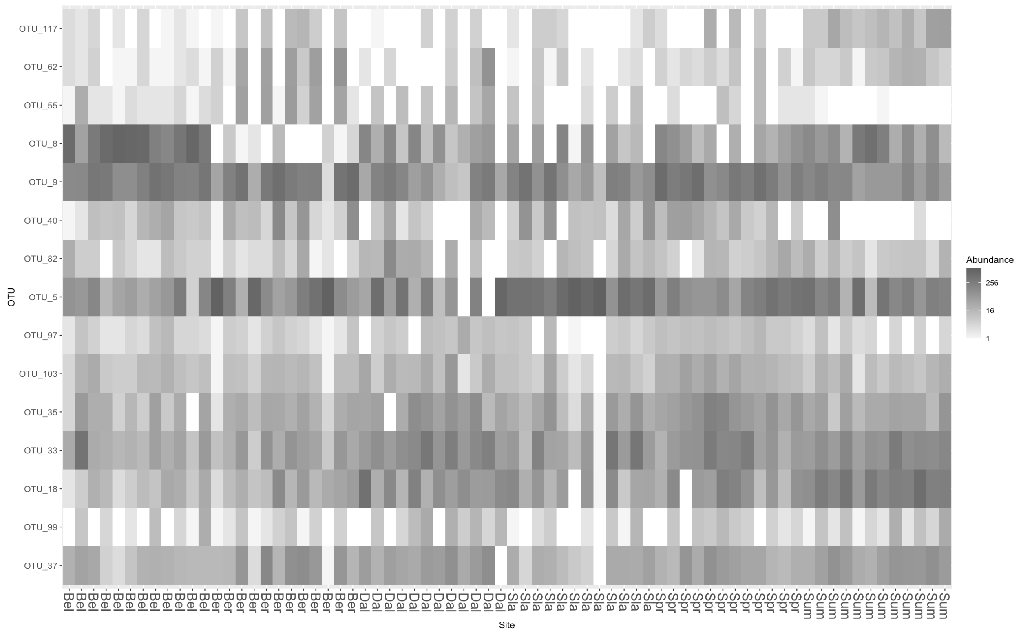
Same figure as before but with OTU labels instead of Genus. We can decide which format would be best and make a final figure.

Slide 17
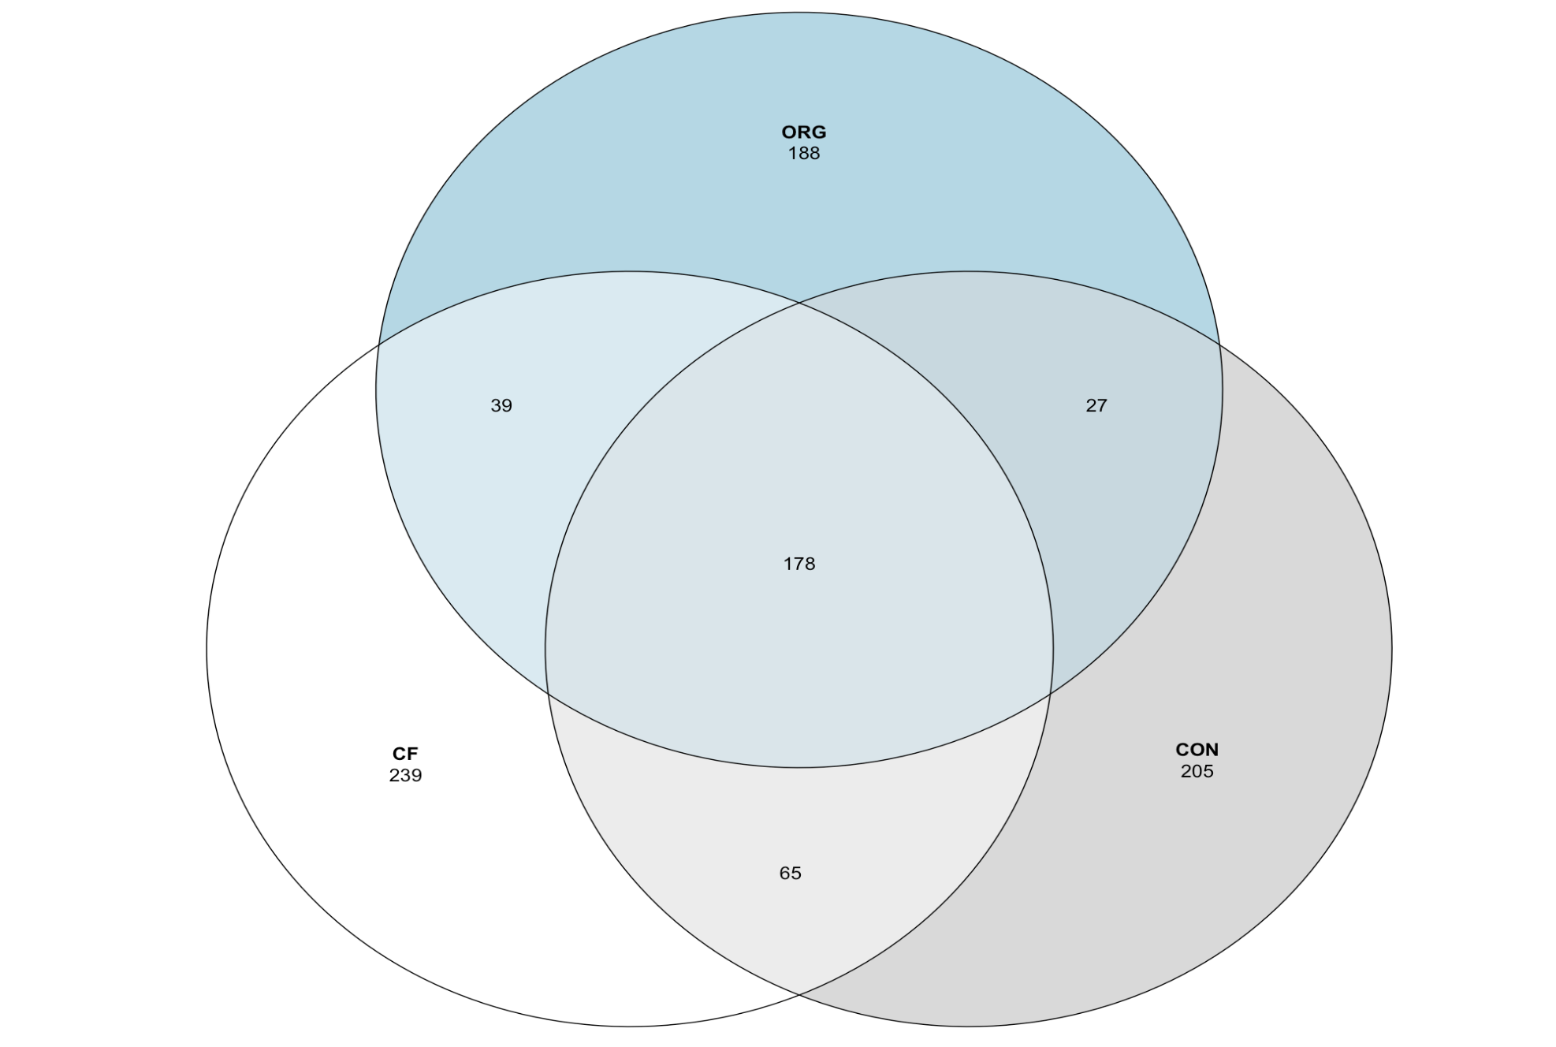
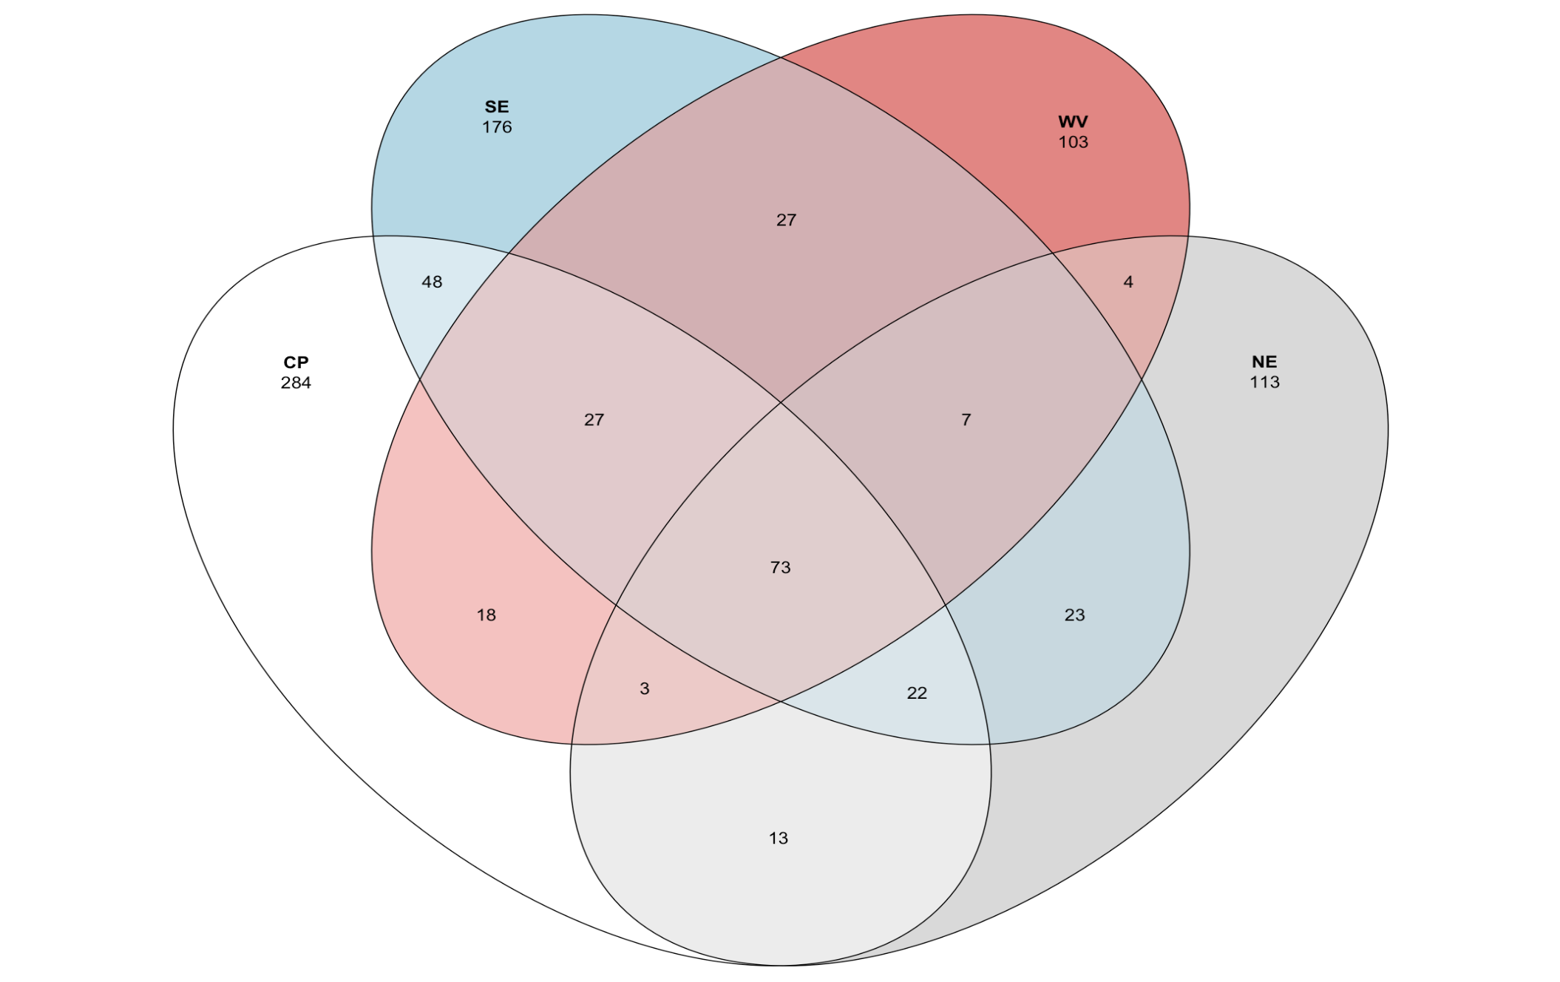
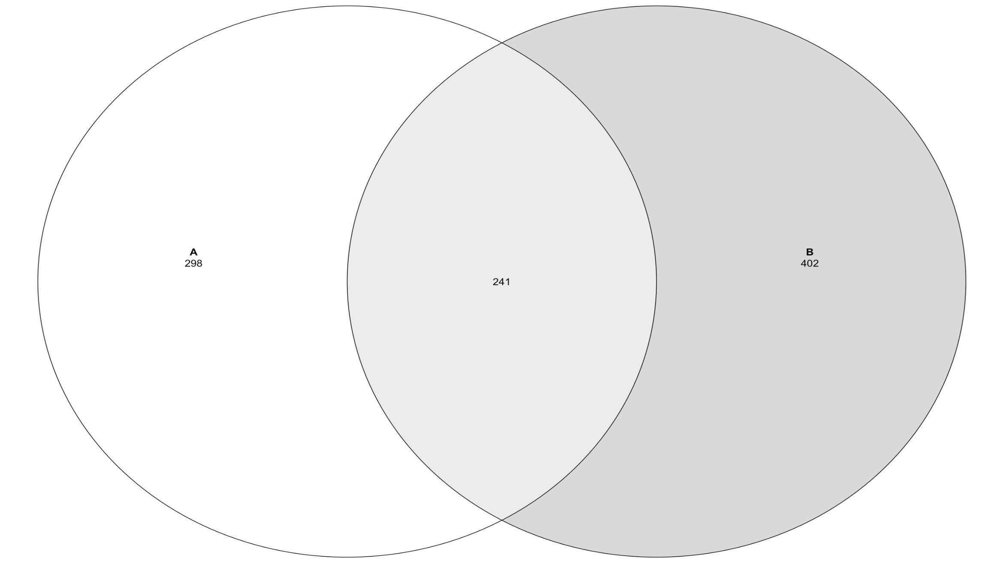
Venn diagrams

Slide 18
Supp. Figures

